Slide 1
Capstone Project Student Applications & Performance
An analysis on student attrition rate in Clearwater State University
By – Rhea Das

Slide 2
Agenda
Project Synopsis
Business Question
Executive Summary
Top 5 Key Drivers of the study
Descriptive Statistics
Quantiles of Financial Aids
Relationship between Finance, Attrition & Population
Relationship between Finance & Housing status of students
Relationship between Attrition & Finance of different Degree groups
Boxplot of Financial Background & Financial aid
Target Variable
Crosstab, Chi-square test of association & Hypothesis
Attrition vs Decile bins
Attrition vs Degree Group
Attrition vs Student Background
Attrition vs Student Housing Status
Attrition vs Student Gender vs Student Nationality
Attrition vs Parents’ Education
Top 10 subjects opted for Major with their respective attrition%
Top 10 Major & Minor subjects
Feature Correlation
Feature Engineering
Model Accuracies
Receiver Operator Curve
Confusion Matrices
Decision Tree Classifier

Slide 3
Project Synopsis
Background
Clearwater State University offers a wide variety of degree programs, from online degrees to a doctorate in education. Programs are offered in the streams of the arts, education, business & nursing.
Objective
Increase enrolment of students
Improve retention, progression and graduation rates
Recruit better academically qualified undergraduate and graduate students
Increase external funding and recognition
Available Data
Data is provided by Jigsaw Academy for capstone project.

Slide 4
Business Question By leveraging on the student demographic data, course preference, performance record, grades, financial background, financial aid etc.
Q1. Identify key drivers of early student attrition.
Q2. Build a predictive model to identify students with higher early attrition risk.
Q3. Recommend appropriate interventions based on the analysis.

Slide 5
Executive Summary
Business Problem
The university wants to increase the enrolment of students and improve retention, progression and graduation rates by understanding the key aspects of student attrition after first year of a course.
Solution
If the student is not returning in second semester then, that concludes that they will attrite in the second year of the course. College should implement rules to reduce that and focus on helping students more with the financial aid with different backgrounds.
Impact
Impact of the study will reduce the student attrition by finding the key aspects that drive the students to drop out within one year of successfully joining the program.

Slide 6
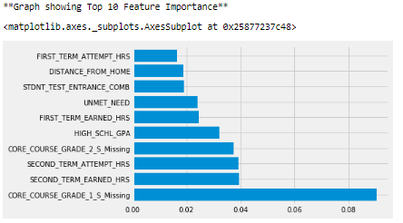
Top 5 Key Drivers of the analysis
Features | Importance | Feature Meaning
CORE_COURSE_GRADE_1_S_Missing | 0.090300 | Grade in Core course 1 in Semester 2 is Missing
SECOND_TERM_EARNED_HRS | 0.039459 | Hours earned by student in Semester 2
SECOND_TERM_ATTEMPT_HRS | 0.039249 | Hours attempted by student in Semester 2
CORE_COURSE_GRADE_2_S_Missing | 0.037437 | Grade in Core course 2 in Semester 2 is Missing
HIGH_SCHL_GPA | 0.032029 | Student's High School GPA score
Findings
This table shows the top 5 features which are high significant influence on the attrition rate.
If a student’s grade is missing on the First paper in second semester then he/she is likely to attrite and not return for the second year of their respective program.
Likely if the high school GPA is not above average, then they are also likely to attrite.

Slide 7
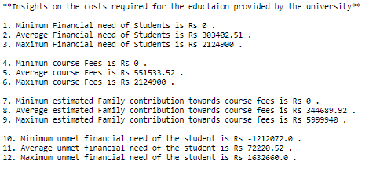
Descriptive Statistics - Financial background & Quantum of aid
University provides financial aid to students as per eligibility.

Slide 8
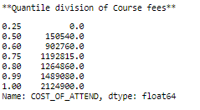
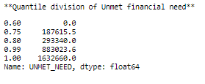
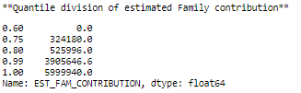
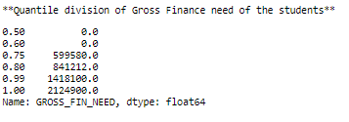
Quantiles of Financial Aids

Slide 9
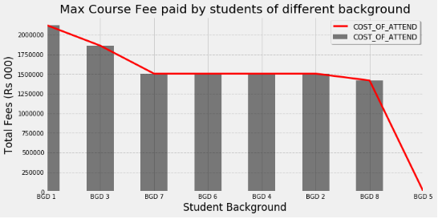
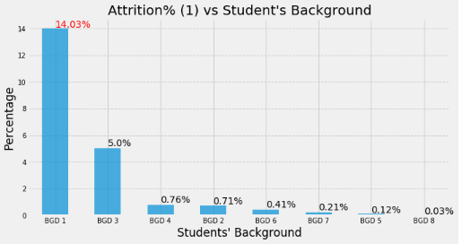
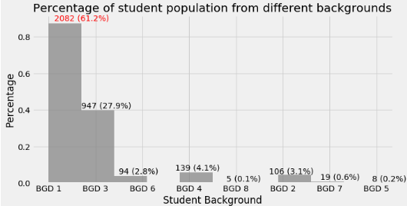
Relationship between Finance, Attrition & Population
Findings:
Students with BGD1 & BGD3 has the highest student population in the university.
Students with BGD1 & BGD3 pays the most fees - University should try and look into this as the attrition percentage is also high among them.
Students with BGD5 do not pay any fees – University should try and allocate financial aids as per eligibility and need of the students.

Slide 10
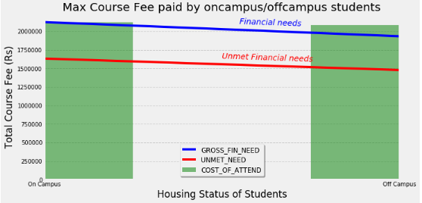
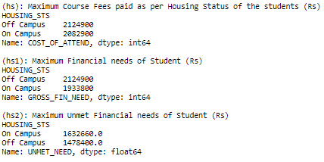
Relationship between Finance & Housing Status of Students
Findings:
The Fee structure is almost equal for on-campus/off-campus students.
Financial needs of the students are more than the unmet financial needs of the students.

Slide 11
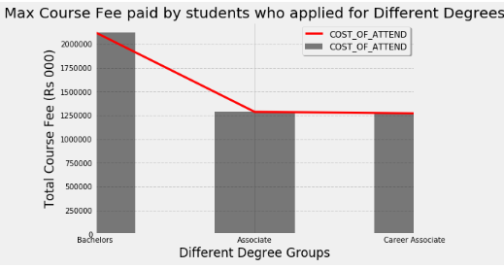
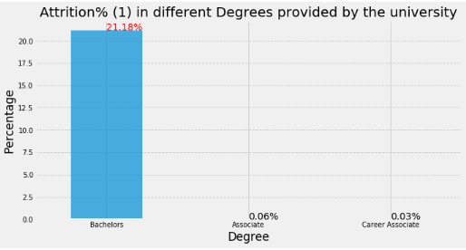
Relationship between Attrition & Finances of different Degrees Groups
Findings:
The highest fees is paid by the Bachelors and also the attrition is also high among them.

Slide 12
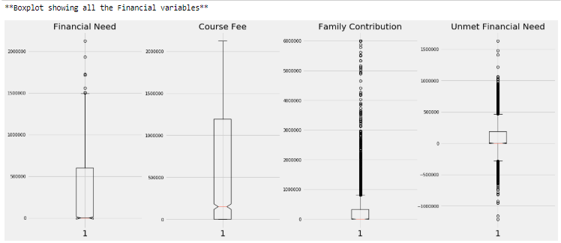
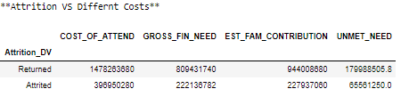
Boxplot of Financial Background & Financial aid

Slide 13
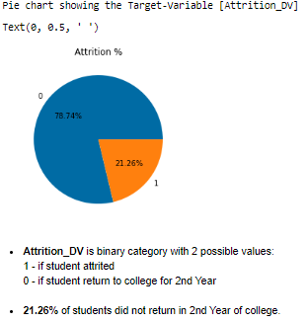

Target Variable - Attrition
Attrition_DV is the target variable derived from the variable RETURNED_2ND_YR.
1 - if student attrited 0 - if student return to college for 2nd Year
The attrition percentage is 21.26%
University wants to reduce this by understanding the relationship between the other features with attrition.

Slide 14
Crosstab, Chi-square Test of Association & Hypothesis
Introduction
The Chi-square test of independence helps find if there is a relationship between two categorical variables.
The data is displayed in a cross-tabulation format with each row representing a level (group) for one variable and each column representing a level (group) for another variable.
The test is comparing the observed observations to the expected observations.
Some other tests are 'g-test','fisher','mcnemar’.
Hypothesis between 2 categorical variables:
-The H0 (Null Hypothesis): There is no relationship between variable one and variable two.
-The H1 (Alternative Hypothesis): There is a relationship between variable 1 and variable 2.
If the p-value is significant, reject the null hypothesis and claim that the findings support the alternative hypothesis.

Slide 15
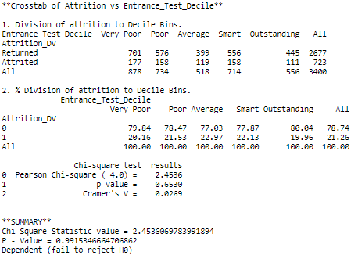

Attrition vs Decile bins
Note: The students are separated into bins of 5 categories to find the relations between the entrance test marks and attrition.
Findings:
As the p-value is more than alpha, H0 is rejected.
Attrition rate is dependant on the student entrance test.
University should prioritize on giving application to students scoring above average.
The students with lower entrance test marks might not return for the second term of their respective programs.
University should provide extra academic support to students with lower marks.

Slide 16
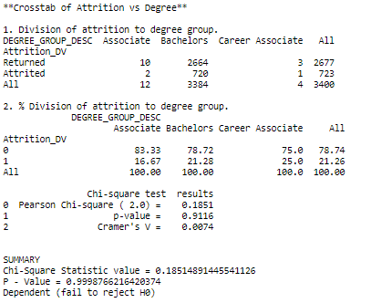
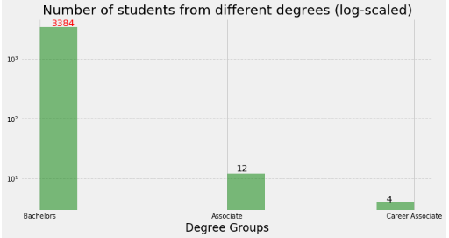
Attrition vs Degree group
Findings:
Attrition is dependant on the Degree group variable.
Attrition is more among the Bachelor students – University should look into the course fees for Bachelors as they pay the highest and also most of the students in the university come to study Bachelors.

Slide 17
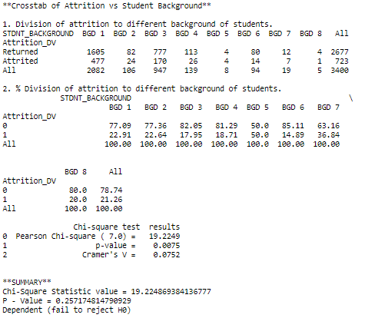
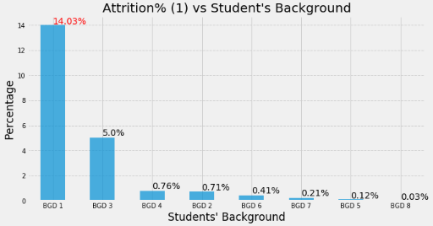
Attrition vs Student Background
Findings:
Attrition is dependent on student’s background.
Students with BGD 1 has the highest attrition rate followed by BDG3.
The reason can be related to the fees paid by the respective students.

Slide 18
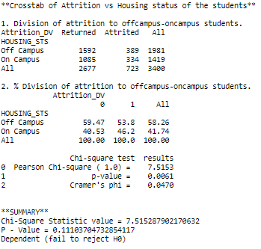
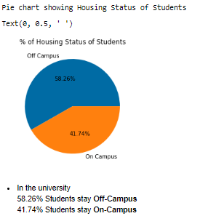
Attrition vs Student Housing Status
Findings:
Attrition variable is dependent on the housing status of the student, hence the University should take better decisions on which students should stay on-campus and the fee structure provided to them.

Slide 19
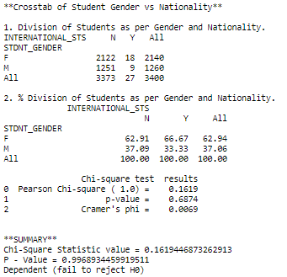
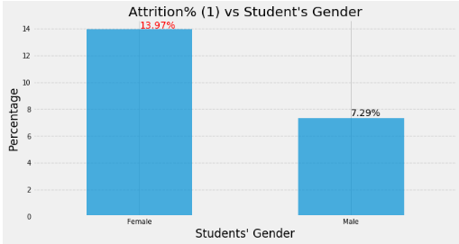
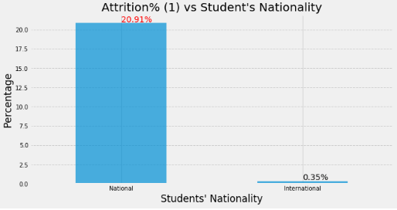
Attrition vs Student Gender vs Student Nationality
Findings:
Student Gender is dependent on Nationality
Attrition is more among female students than males
Attrition more among National students.

Slide 20
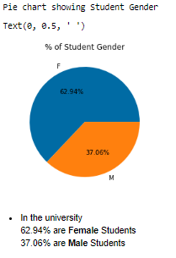
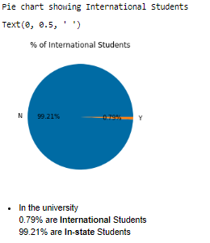
continued..
Findings:
Attrition is more among female students than males – University should promote more to get female students back.
Attrition more among National students – University should give financial aids to National students also.

Slide 21
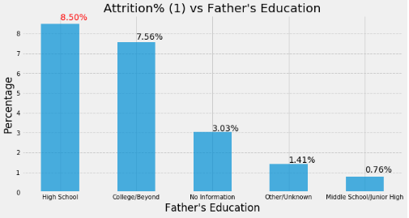
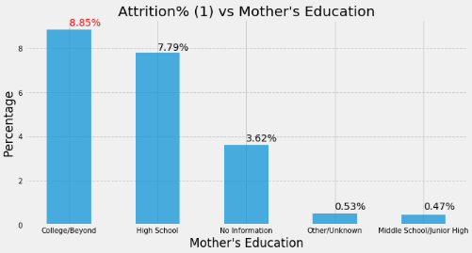

Attrition vs Parents’ Education
Findings:
The level of parent’s education is an important to for student’s attrition.
If The parents are highly educated, the student is likely to complete the course.

Slide 22
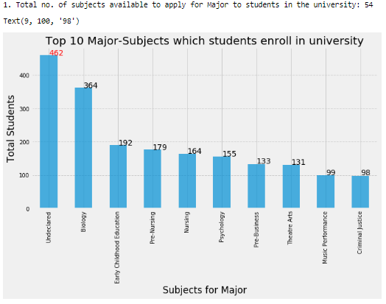
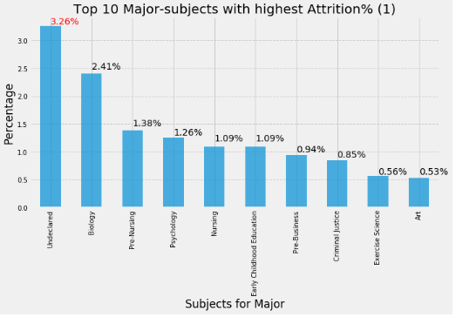
Top 10 subjects opted for Major with their respective attrition%
Finding
Most of the students have undeclared major subjects, which also have very high attrition%.
University should help students in enrolling for major subjects to help them throughout the course.

Slide 23
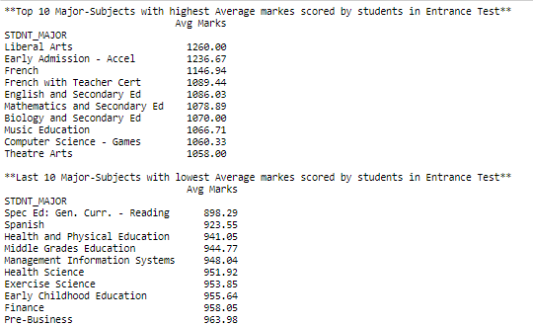
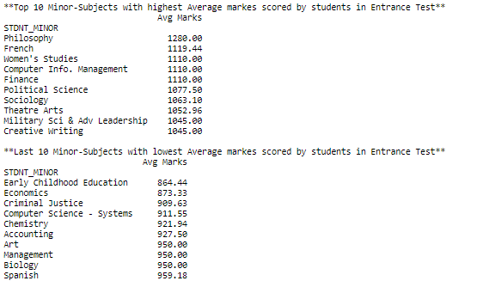
Top 10 Major & Minor subjects with highest average marks entrance test

Slide 24
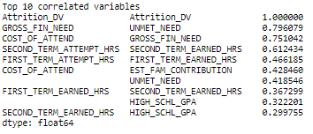
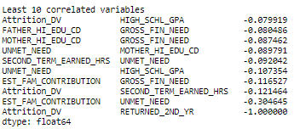
Feature Correlation
Top 10 variables with positive correlation:
These variables have a positive impact on the target variable [Attrition_DV].
If there is an increase in any of these variables, Target variable moves in a positive direction.
If there is a decrease in any of these variables, Target variable moves in a negative direction.
Top 10 variables with negative correlation:
These variables have a negative impact on the target variable [Attrition_DV].
If there is an increase in any of these variables, Target variable moves in a negative direction.
If there is a decrease in any of these variables, Target variable moves in a positive direction.

Slide 25
Feature Engineering – one hot encoding
Decision for one-hot encoding
Having 1360 dummy variables in the train & test will impact accuracy in the model.
Large no. of features will lead to curse of dimensionality.
Limit One-hot encoding to the top 10 most frequent labels of the variable (1 and 0) - this results into 1 binary variable for each of the top 10 most frequent labels and remaining labels will be dropped out.
Creating subset from the main data with only the columns where feature engineering is required i.e. the columns which have category level more than 20.
Advantage:
Straight-forward to implement
Does not require hours of variable exploration
Does not expand massively the feature space
Disadvantage:
Does not add any information that may make the variable more predictable
Does not keep the information of the labels ignored
Note: Categorical variables usually have a few dominating categories and the remaining are just white noise.

Slide 26
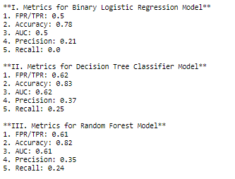
Model Accuracies
3 Machine learning models were built for classification
Binary Logistic Regression Model
Decision Tree Classifier
Random Forest Model
Model Accuracy Summary Description:
FPR/TPR - False Positive Rate & True Positive Rate in the confusion Matrix.
Accuracy - Computes the number of correctly classified data points with respect to the total data points.
AUC - Area under Curve
Precision - Of all the points that the model predicted to be positive, how many of them are truly positive.
Recall - Of all the actually positive points, how many of them the model predicts as positive.

Slide 27
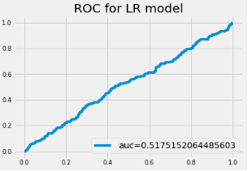
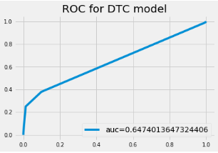
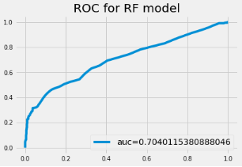
Receiver Operator Curve – for the models built
ROC is very flat for the Binary Logistic Regression Model and AUC is 0.5.
Hence this is not a good model.
ROC is a bit better for the Decision Tree Classifier Model and AUC is 0.65.
Hence this is a better model.
ROC is moderately good for the Random Forest Model and AUC is 0.71.
Hence this is a better model.

Slide 28
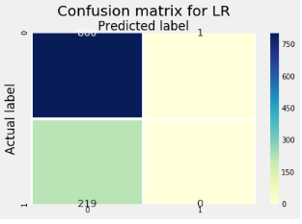
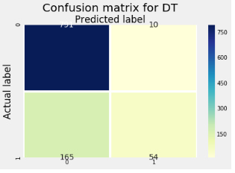

Confusion Matrices – for the models built
Confusion Matrix for Random Forest Model:
TP – 791
FN – 165
FP – 10
TN – 54
Confusion Matrix for Logistic Regression Model:
TP – 800
FN – 219
FP – 1
TN – 0
Confusion Matrix for Decision Tree Model:
TP – 791
FN – 165
FP – 10
TN – 54

Slide 29
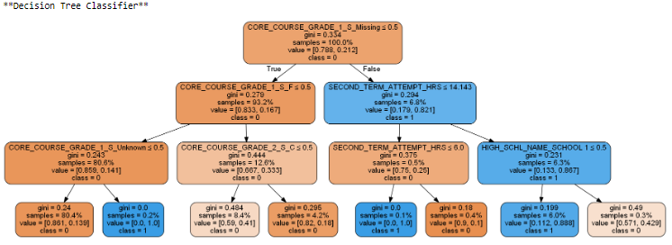
Decision Tree Classifier

